Slide 1
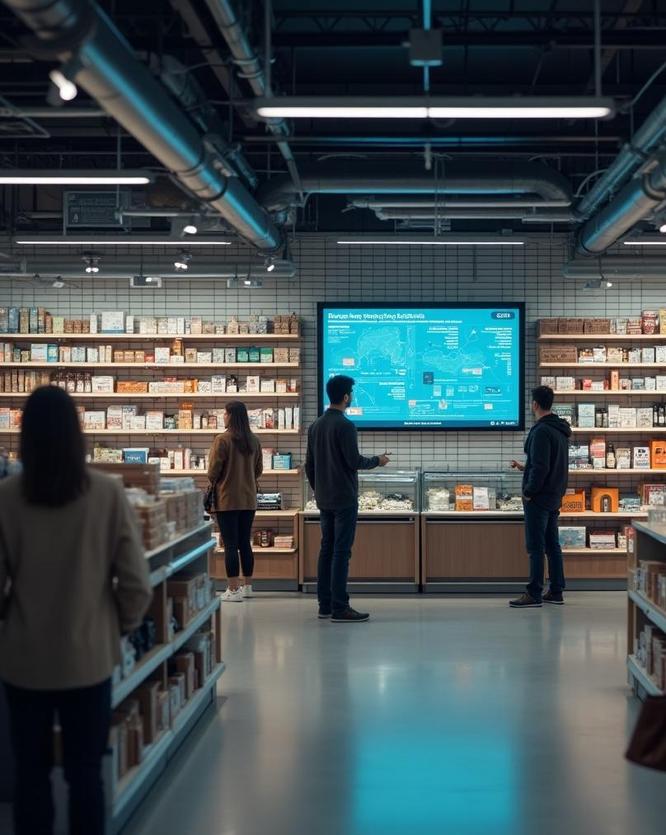
Deep Learning for Retail Evaluating CNN Architectures for Object Detection and Stock Monitoring in Complex Retail Shelf Scenarios
Leveraging AI technologies to manage retail inventory effectively
Leveraging AI technologies to manage retail inventory effectively.
2XXX

Slide 2
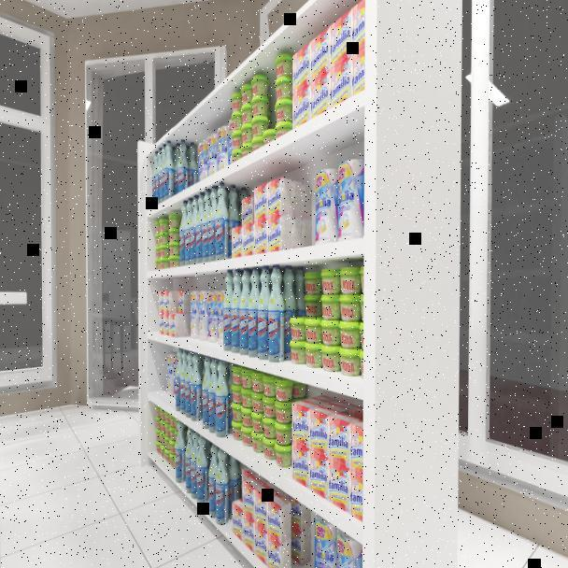
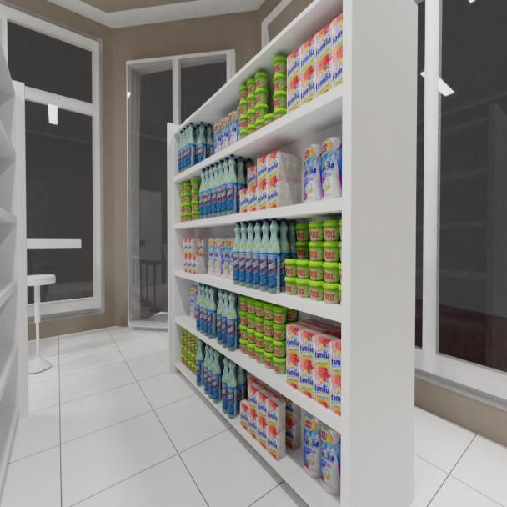
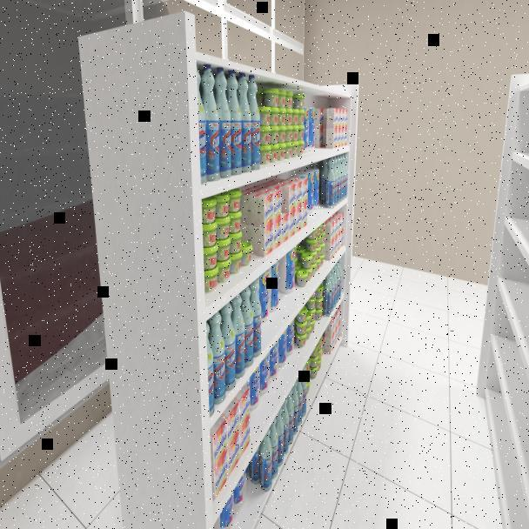
Introduction
This presentation explores the application of deep learning in retail environments, if they can facilitate inventory checks and detecting misplaced items on shelves under complex shelf environments.
Fig 1: Dataset images used in study of product placements and detections of different shelf orientations.

Slide 3
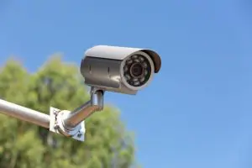
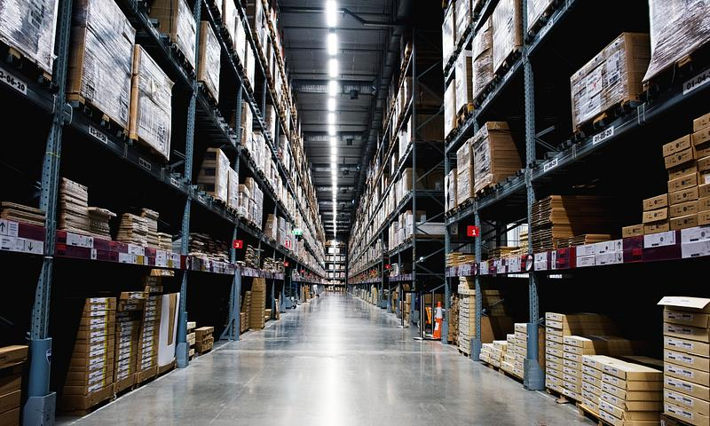
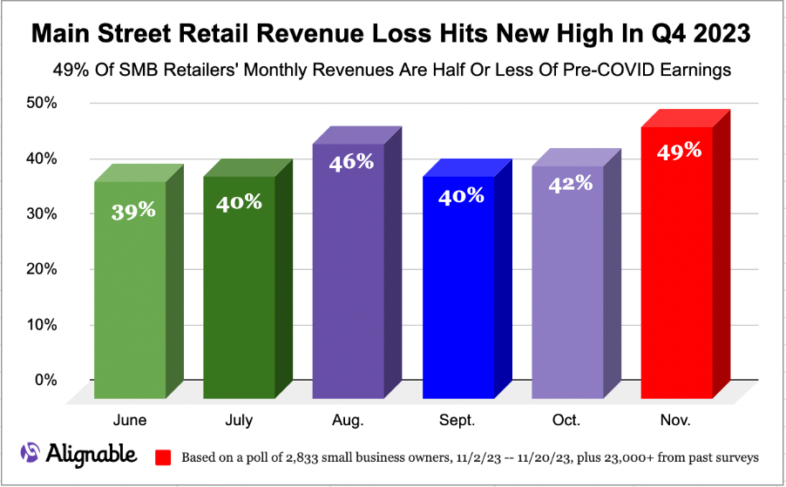
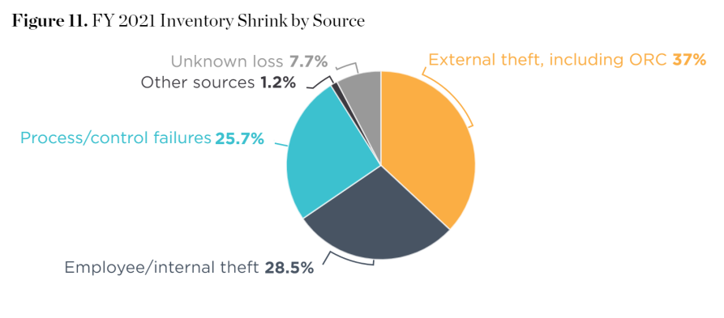
PROJECT MOTIVATION
Poor customer satisfaction
Revenue losses for retailers due to misplaced products
Shelf inventory Shrinkage
Errors in traditional methods of detection(CCTV) for varied angles.
Figure 3: Inventory shrink by sources, Retail Security Survey(Source: U.S. Census Bureau, NRF calculations).
Figure 2: Graphical representation of revenue losses(Casto, 2023).

Slide 4
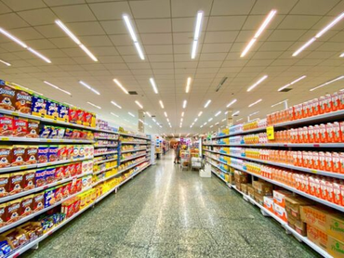
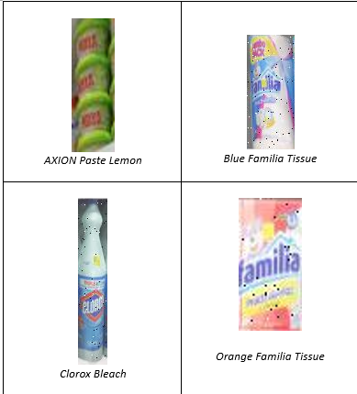
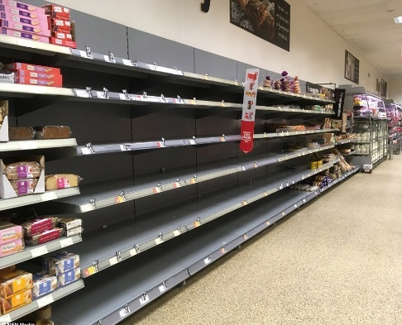
PROJECT AIMS
Shelf Inspection: Identify in-store and on-display items on the shelf: By classifying products by labels
Shelf monitoring: Count the labelled items by class
Out-of-stock and misplaced items analysis: Identify empty areas and areas of misalignment on the shelf

Slide 5
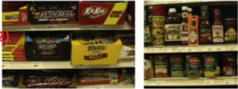
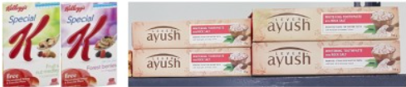

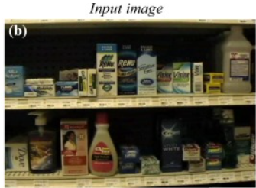
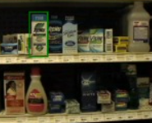
Previous Studies: Traditional ML solution
Santra & Mukherjee, 2019; Varol et al., 2014 used frontal, camera-captured well-lit shelf images and controlled conditions, using gradient and color-based features for detection and classifying having Recall of 0.85, Precision of 0.81 But they failed in varied orientations or poor lighting.
Figure 4:Traditional feature-based detection (Santra and Mukherjee, 2019; Varol et al., 2014).
Franco et al. (2017): Deep models achieved better recall(0.97) than traditional CV(0.94) for object detection, that used object corners and color information and required fixed orientation and consistent lighting.
Figure 5: Deep learning-based object localization evaluated on GroZi-120 and Grocery Products (GP) datasets (Franco et al., 2017).

Slide 6
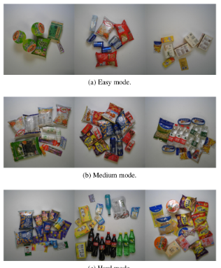
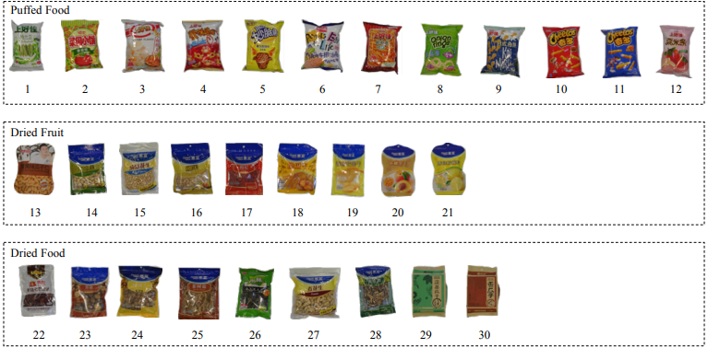
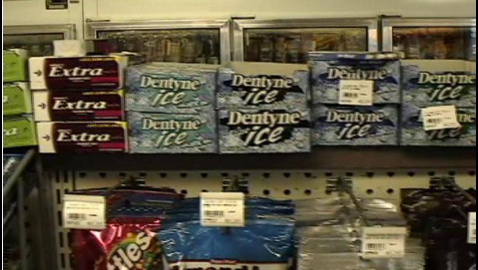
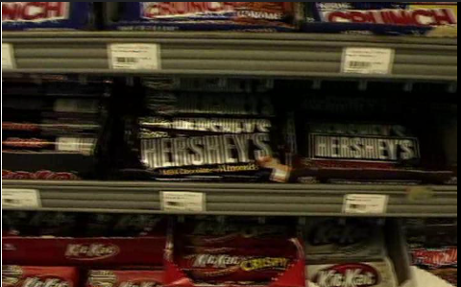
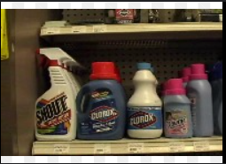
Deep learning solution
The authors fine-tuned a pre-trained Faster R-CNN object detection model (originally trained on MS COCO) to detect and localize products for product checkout. For multiple cluttered products, they obtained an accuracy of 96.57% for just detection. This alone is not suitable, since they used clean background and consistent lighting which is not always the case for real-world retail environments(Wei et al., 2020, Figure 6)
Figure 6: Retail Product Checkout dataset(Source: Wei et al., 2020)
Dataset images, adapted from the study by Abraham and Joseph (2022), obtained a precision of 86.4% and recall of 77.6%. They wanted to solve key challenges in retail shelf scenarios—such as data distribution, product variability, and uneven lighting—that affect deep learning-based grocery product detection and recognition using the publicly available Grozi-120 dataset.
Figure 7: Grozi-120 dataset(Source: Abraham, Joseph. (2022)).

Slide 7
PROBLEM STATEMENT
Our study focuses on evaluating the existing solutions, limitations they face, and integrating Deep learning to train and enhance these issues, which otherwise would be performed by a human operator.
01
02
03
SCOPE OF THE STUDY
RELEVANCE OF THE STUDY
RESEARCH QUESTION
Our study aims to pinpoint challenges, opportunities and assess feasibility in stock inventory methods and product identification in retail stores.
Understanding the retail implications is crucial for businesses aiming to stay competitive and meet evolving customer needs.
How effective are deep learning-based computer vision models in assisting shelf monitoring and detecting stock presence in medium-scale retail stores, particularly under varied lighting and shelf orientations?

Slide 8
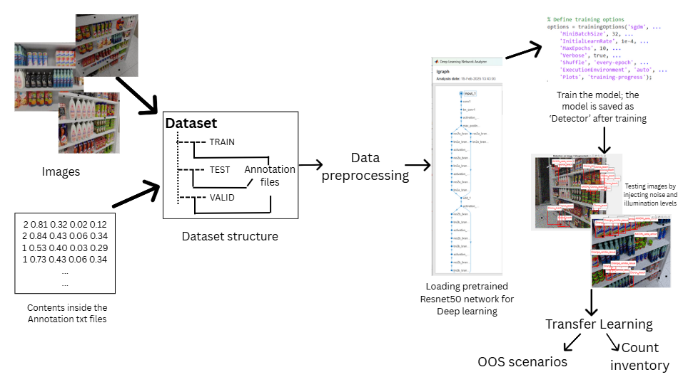
Methodology: Object detection
Dataset: Shelf images annotated with bounding boxes (YOLO format)
Architecture: Faster R-CNN with VGG-16, Resnet-50 backbone & Roboflow
Transfer Learning:
Initialized with pretrained (ImageNet weights)
Replaced final 3 layers:
Classification layer
Fully connected layer
Softmax layer
Only the new layers were trained; early layers were frozen
Training:
Used SGD optimizer with custom training options
Evaluation:
Tested on noise & illumination variation on test images
Fig. 8: Workflow for retail shelf object identification using transfer learning with ResNet-50 and VGG-16, highlighting data preprocessing, training, and testing under varied conditions.

Slide 9
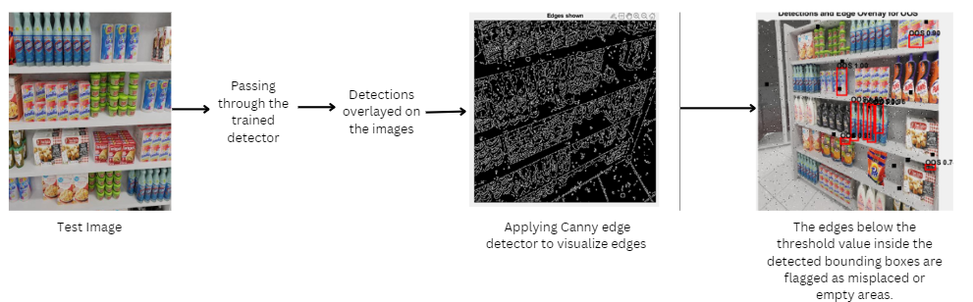
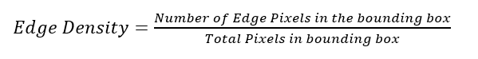
Methodology: OOS & Misplaced Items
Test Image converted to Grayscale
Density threshold set between 0.11 to 0.18
OOS is flagged as per the equation below:
Fig. 9: Workflow for retail shelf empty areas and misplaced areas detection using Canny Edge detector Algorithm.

Slide 10
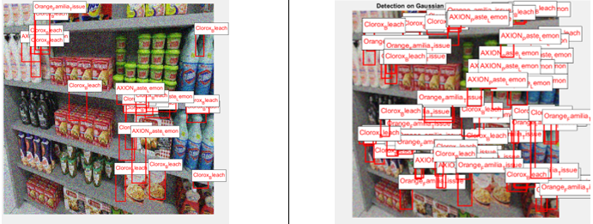
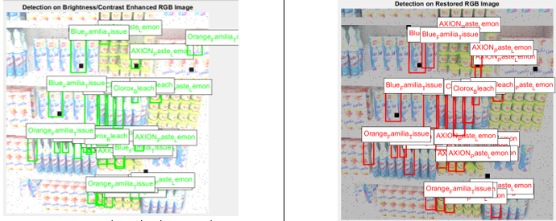
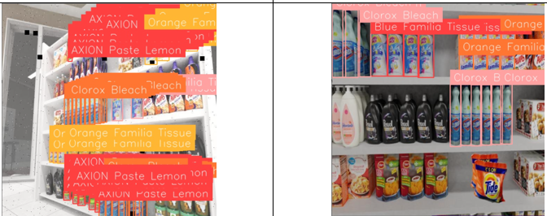
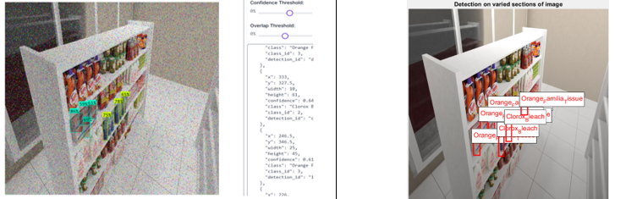
Testing: Object detection and classification
Identification Outcome with Gaussian Noise and Denoising on Resnet50 backbone
Identification Outcome with illumination Adjustment and filtering
Fig 11: Improved identification accuracy under enhanced illumination; AXION missed due to size, partial recall for Blue Familia class(Left). Post filtering yields consistent predictions and no mispredictions, except for Orange familia class in low contrast regions(Right).
Fig 10 : Reduced detection accuracy with Gaussion noise(Left); More predictions but many false positives after denoising (Right)
Identification Outcome with Original test images on Roboflow
Identification Outcome with Salt & Pepper noise and illumination levels at regions of the image
Fig 12: Accurate identification and bounding box of all labelled shelf products using YOLO and transformer models with improved recall across orientation and viewing angles
Fig 13 : On-display products were identified for original images on Roboflow(Left); After illumination levels, Resnet50 was able to perform at par with Roboflow

Slide 11
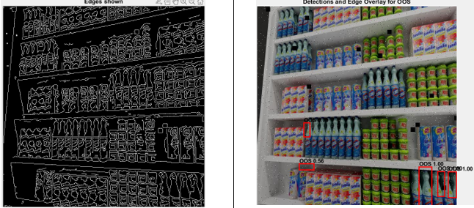
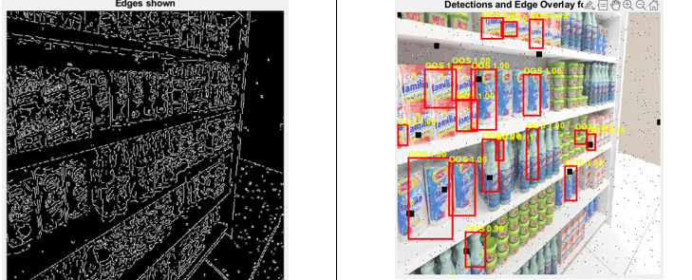
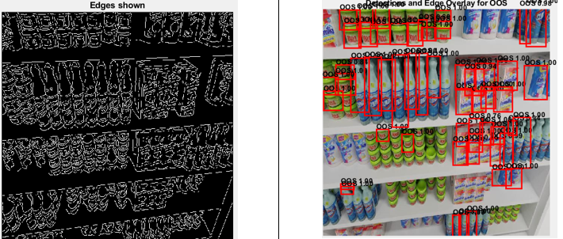
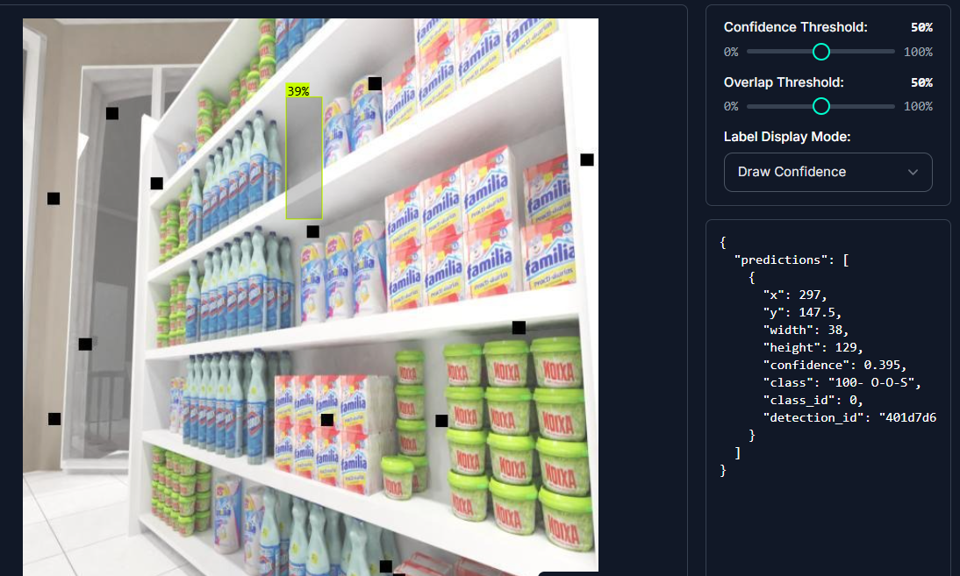
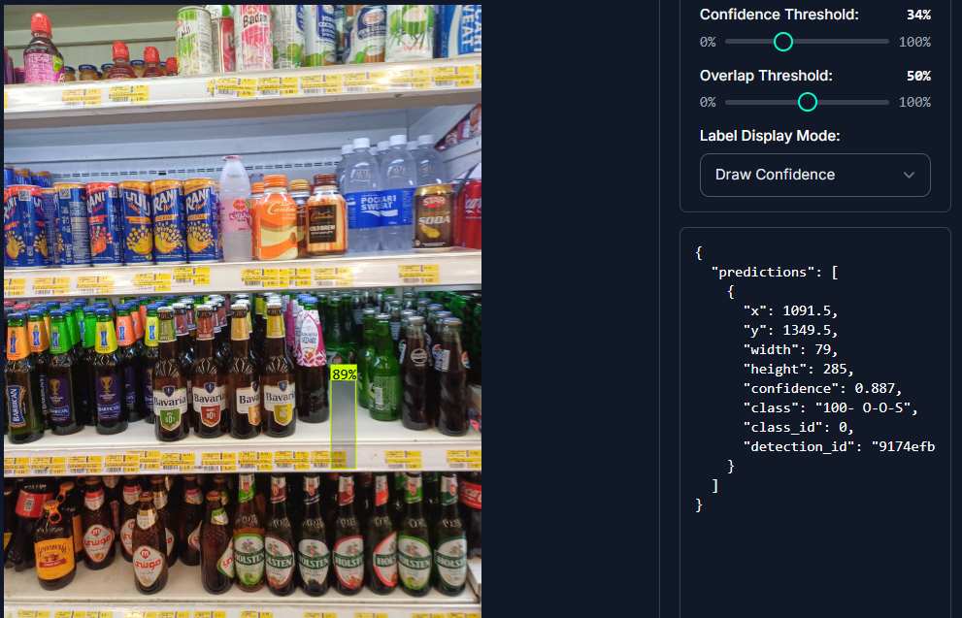
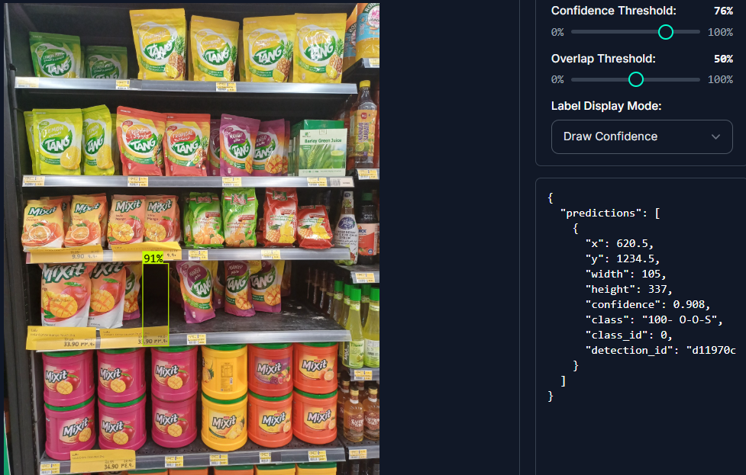
Testing: Edge based Analysis for Out-of-Stock and Misplaced Items detection
Edge and Detection overlay for Threshold of 0.18
Edge and Detection overlay for Threshold of 0.15
Fig 14: Edge map of product and shelf boundaries using threshold-based detection (Left); Empty areas overlayed with edge contours; false positives appear between closely spaced items like Clorox(Right).
Fig 15: Correct Empty shelf regions in front of Blue familia and AXION products. Misplaced item indicators on orange familia class, due to tilted camera angle(Right).
Edge and Detection overlay for Threshold of 0.11
Empty areas detection using camera captured shelved images
Fig 16: Limited correct detection of empty areas between AXION products needing restocking, predominant false positives for Clorox bottles due to product characteristics and close spacing.
Fig 17: Original test dataset detection (left), camera captured shelf gap identification (middle), and accurate empty/misplaced product localization (right) using RoboFlow-trained empty shelf dataset.

Slide 12
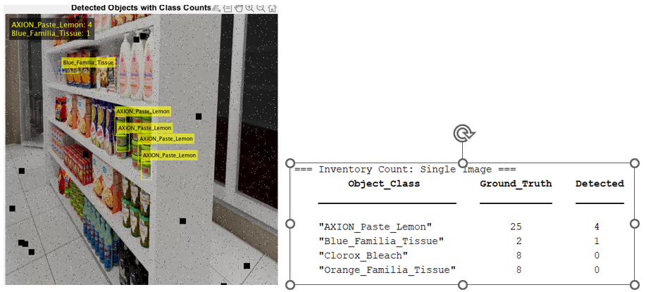
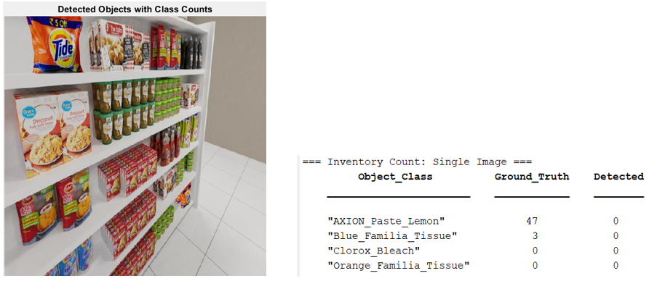
Limitations
Observed detections vs actual objects present
Extreme side and bottom angles
Characteristics for small products
Not suitable for inventory management and deployment to the retailers and needs refinement.
Edge cases with complex orientations
Canny edge detector had limited success in densely spaced objects.
For shelf monitoring, only 1% of complex orientations missed, but still relevant for full shelf coverage.
Figure 18: Counts displayed on the original test images at extreme angles for IoU>=0.5
Figure 19: Counts displayed on the original test images at extreme angles for IoU>=0.5

Slide 13
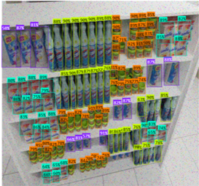
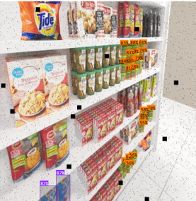
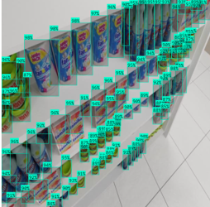
Conclusion
R-CNN pipeline using ResNet-50 and VGG-16 showed high precision (>99%) but low recall for object classes.
Roboflow models performed well for object identification and can be studied for inventory and stock management to deploy to retail shops
Best performance for front-facing, upright labels; struggled with extreme angles and small-sized items.
Dataset imbalance may have caused bias toward frequent classes.
Improved detections and less false predictions observed with illumination level adjustments and ideal orientation (front-facing).
Figure 20: DETR based transformer model predictions for in-store and display at excellent confidence scores

Slide 14
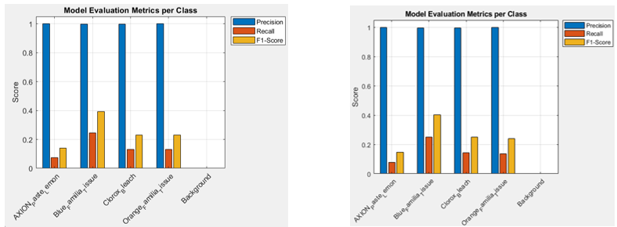
Future Work
Balance the dataset and improve annotations to reduce class bias.
Improve recall for densely packed and angled items.
Study for larger packaged products at different orientation
Use transformers (DETR) and YOLOv11 models for better generalization.
Employ video-based tracking for real-time monitoring instead of static images.
Apply data augmentation and include varied inclined angles to train.
Fig 21: Precision dominance, recall limitation, and F1-score variation across AXION, Blue_familia_tissue, Clorox_bleach, Orange_familia_tissue, and background classes for two model evaluations.

Slide 15


Slide 16
References
Abraham, Joseph. (2022). A Deep Learning Framework for Grocery Product Detection and Recognition. Food Analytical Methods. 15. 10.1007/s12161-022-02384-2.
Wei, Y., Tran, S., Xu, S., Kang, B. and Springer, M., 2020. Deep learning for retail product recognition: Challenges and techniques. Computational Intelligence and Neuroscience, [online] 2020, Article ID 8875910.
Franco, D. Maltoni, S. Papi, Grocery product detection and recognition, Expert Systems with Applications 81 (2017) 163–176.
Santra B., Mukherjee D. P. A comprehensive survey on computer vision based approaches for automatic identification of products in retail store. Image and Vision Computing. 2019;86:45–63. [Google Scholar]
Savani, N. and Lunagaria, M., 2022. A Survey on Identification of Grocery Store Items Using Deep Learning in Retail Store. In ICT with Intelligent Applications: Proceedings of ICTIS 2022, Volume 1 (pp. 553-564). Singapore: Springer Nature Singapore.

